Slide 1
Into to python GUI
Dr Mohammed Bahja

Slide 2
About Python GUI
Python is an interactive programming which has multiple options for developing GUI (Graphical User Interface). Some of them are:
Kivy - Linux, Windows, OS X, Android, IOS, Raspberry Pi 2.
PyQT - Linux, Windows, OS X, Android, IOS 3.
PyForms - Linux, Windows, OS X 4.
WxPython - Linux, Windows, OS X 5.
Tkinter - Linux, Windows, OS X

Slide 3
About Tkinter
Tkinter is a Python module that provides a simple and easy-to-use interface to the Tk GUI toolkit.
Tkinter is the most commonly used Python module for creating graphical user interfaces (GUIs) and is included with the standard Python distribution.
It is written in Python and provides an interface to the Tcl/Tk GUI toolkit, which is used to create graphical user interface elements such as buttons, menus, and text fields.
With Tkinter, you can easily create simple and user-friendly graphical user interfaces for your Python applications.
It’s built in library so no need to install. Just need to import.

Slide 4
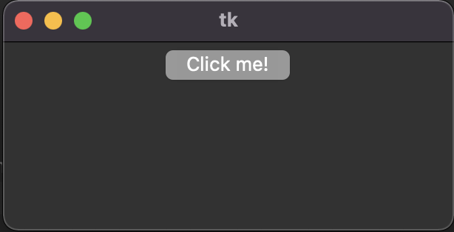
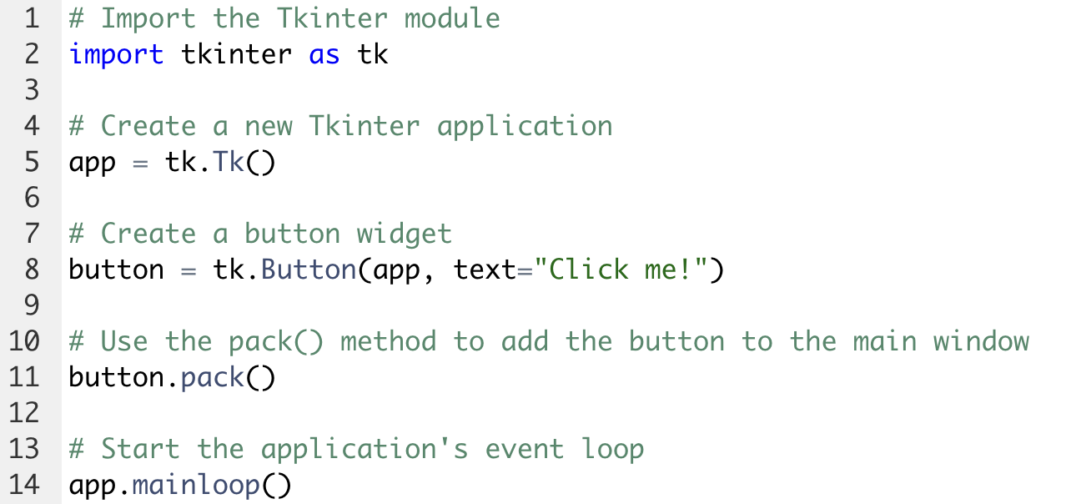
How it work?
Tk() - To create a main window, tkinter offers a method Tk()
mainloop() - is an infinite loop used to run the application, wait for an event to occur and process the event as long as the window is not closed.

Slide 5
Widget
Tkinter provides various controls, such as buttons, labels and text boxes used in a GUI application.
There are currently 15 types of widgets in Tkinter.
1. Button
2. Canvas
3. Checkbutton
4. Entry
5. Frame
6. Label
7. Listbox
8. Menubutton
9. Menu
10. Message
11. Radiobutton
12. Scrollbar
13. Text
14. Toplevel
15. Photolmage

Slide 6
Geometry Configuration
Tkinter offers access to the geometric configuration of the widgets which can organize the widgets in the parent windows.
There are mainly three geometry manager classes class.
pack() - organizes the widgets in blocks
grid() - organizes the widgets in grid (table-like structure)
place() - organizes the widgets by placing them on specific positions
Once a widget has been created, you can use Tkinter methods, such as pack(), grid(), and place(), to control the positioning and arrangement of the widget in the GUI.

Slide 7
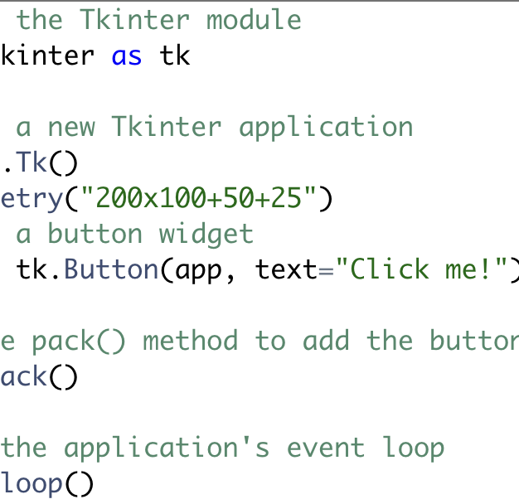
How to add a Widget?
To add a widget to a Tkinter GUI, you first need to create the widget using the appropriate Tkinter class, such as Button, Label, or Entry.
Once the widget has been created, you can use a layout manager, such as pack() or grid(), to position the widget within the GUI.

Slide 8
Widget options
Widget options are configuration settings that control the appearance and behavior of a widget in a Tkinter GUI.
These options are specified when the widget is created using the appropriate Tkinter class.
For example, the Button() class has options such as text and command that are used to set the label text and the function that should be called when the button is clicked, respectively.
Each Tkinter widget class has a different set of options that can be used to customize the widget. Some common options that are shared by many widget classes include bg (background color), fg (foreground color), and font (font style and size).

Slide 9
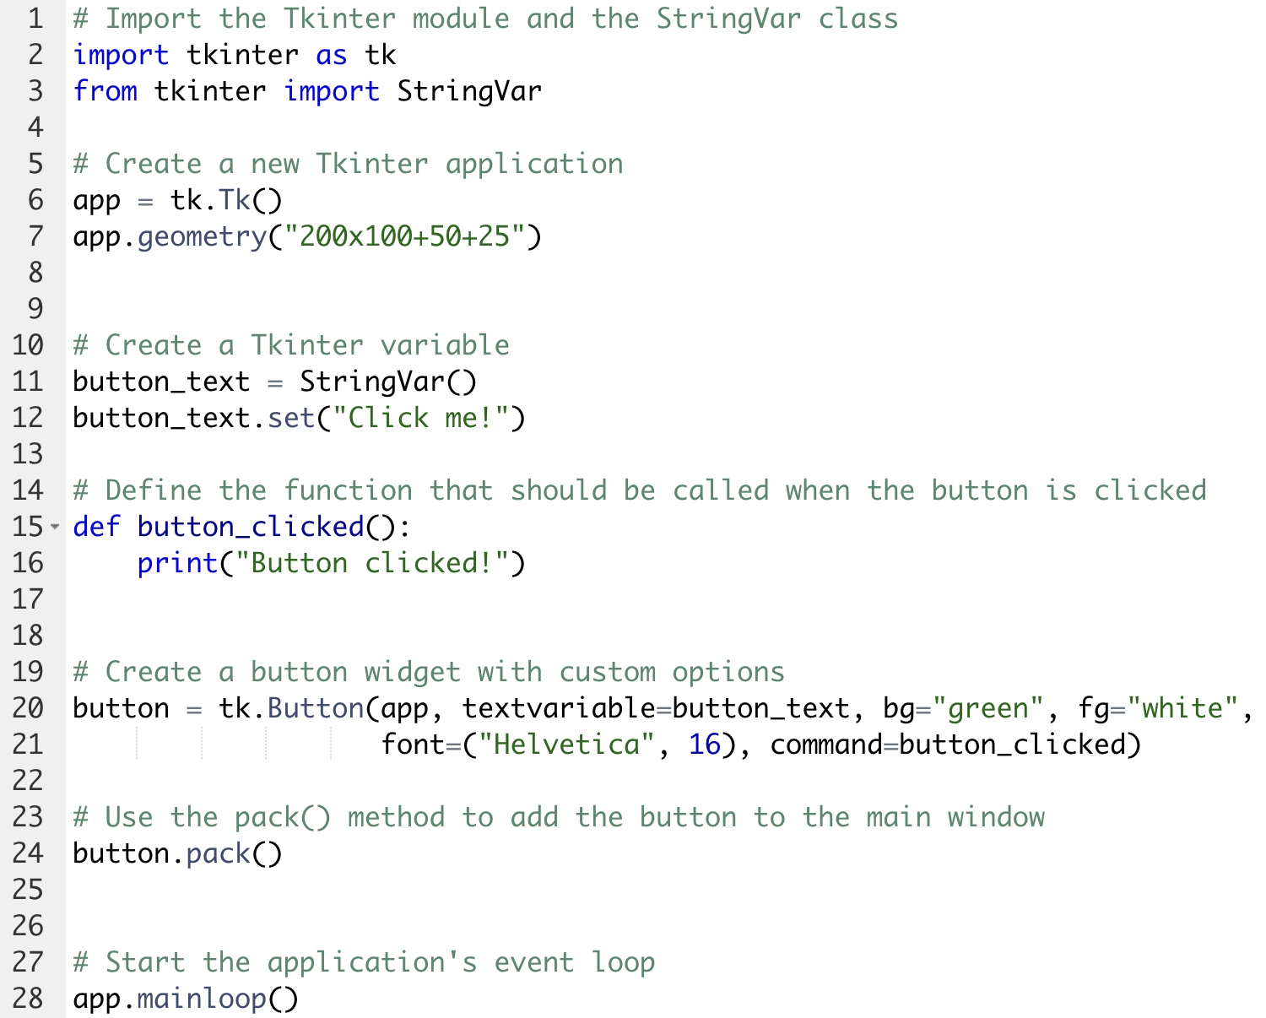
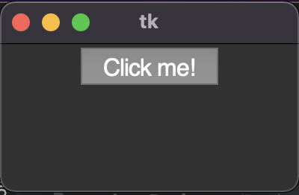
Widget options
Here is an example of how to use widget options to customize the appearance and behavior of a Tkinter button:

Slide 10
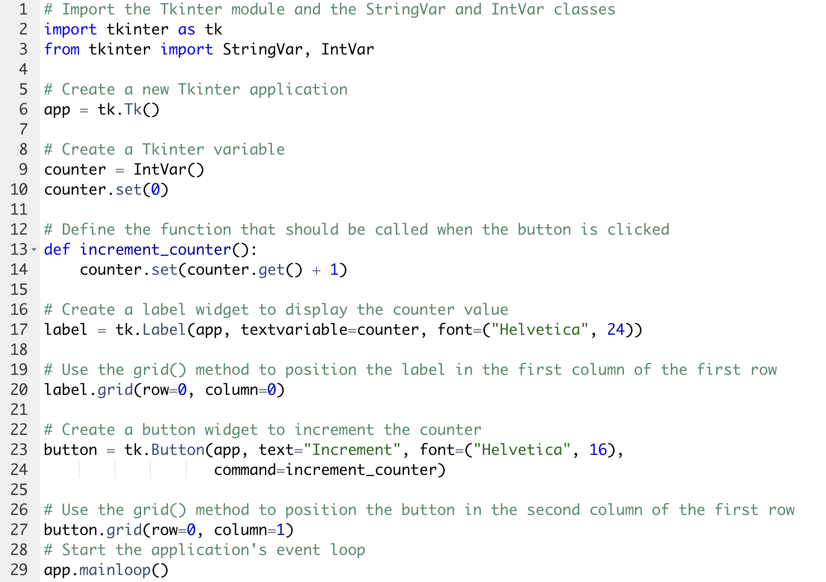
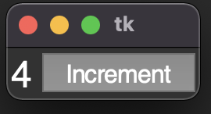
Widget options
Here is another example that shows how to use multiple widgets and layout managers to create a more complex Tkinter GUI
:

Slide 11
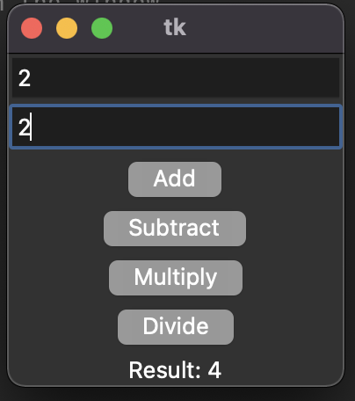
Live coding
Let’s build a simple calculator together

